Slide 1


INT-362
KVM install

Slide 2
Set up nested virtualization in VMWare Workstation
Navigate to the VM Settings - Hardware page for the VM you would like to edit.
Click Edit in the Guest OS settings section.
Click the checkbox for Enable nested virtualization.

Slide 3
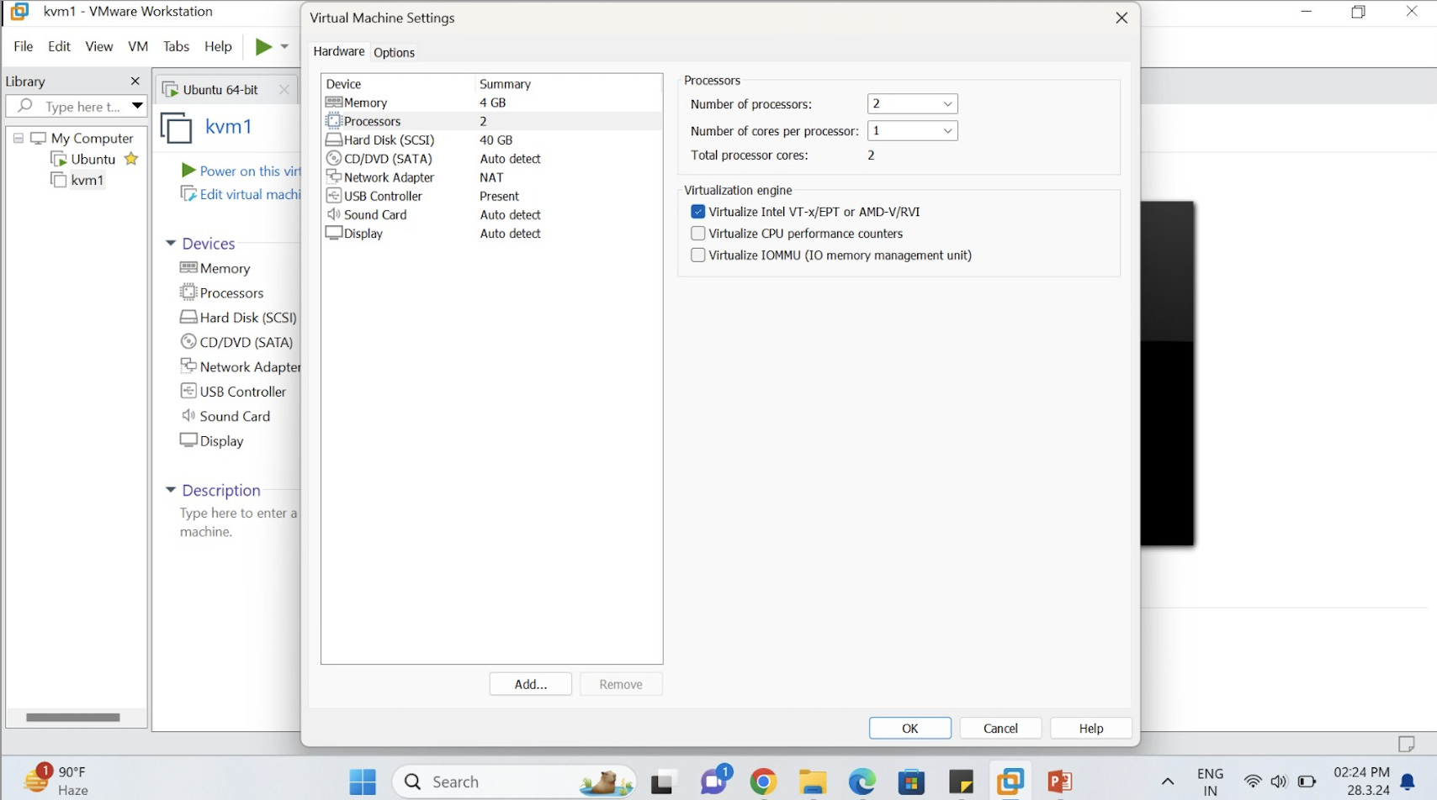
Set up nested virtualization in VMWare Workstation

Slide 4
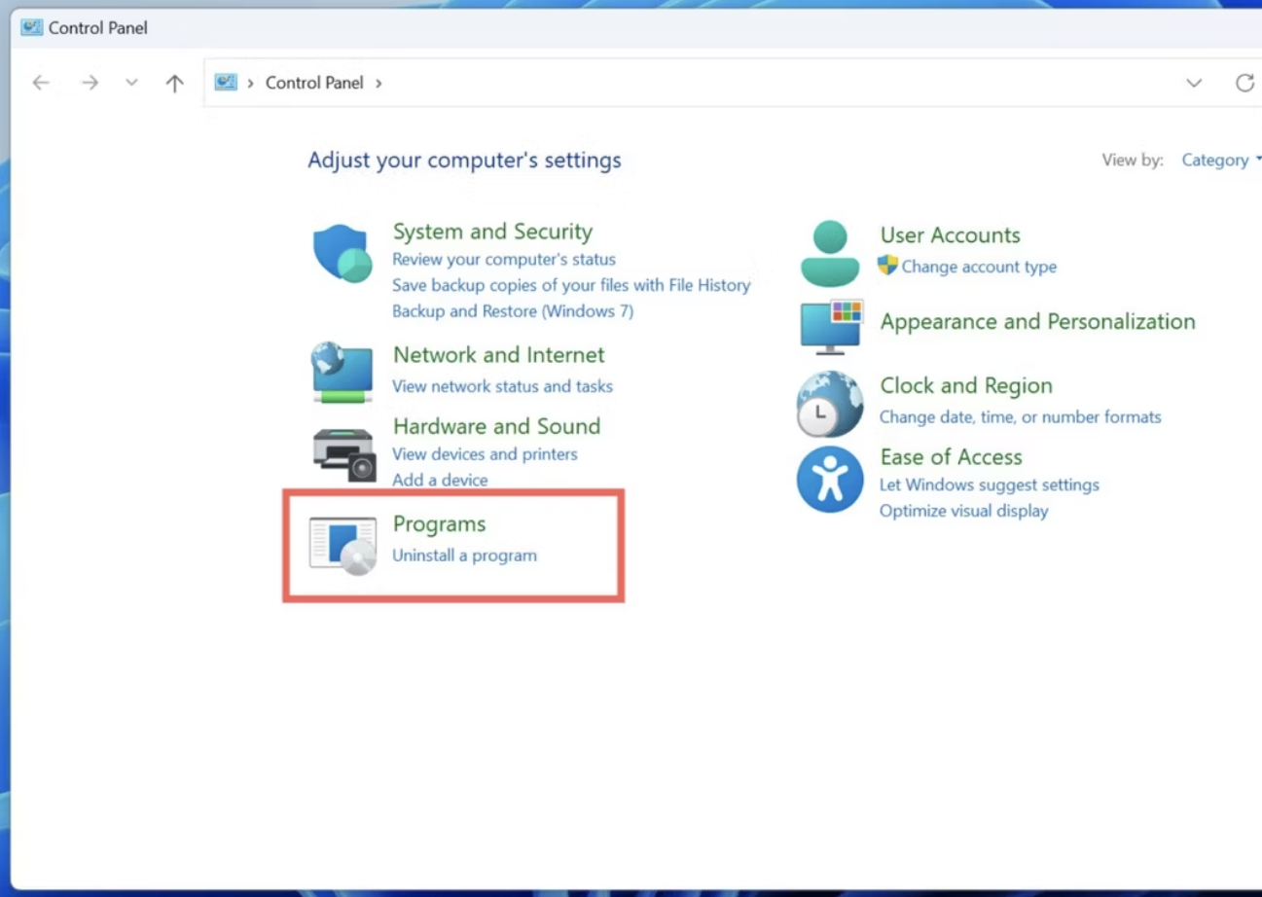
How to disable Hyper-V in Windows 11 using Control Panel
The simplest way to turn off Hyper-V on your PC involves navigating through Windows Features in the Control Panel.
Type "Control panel" into the Search Bar and click on the Control Panel suggestion.
Click on Programs

Slide 5
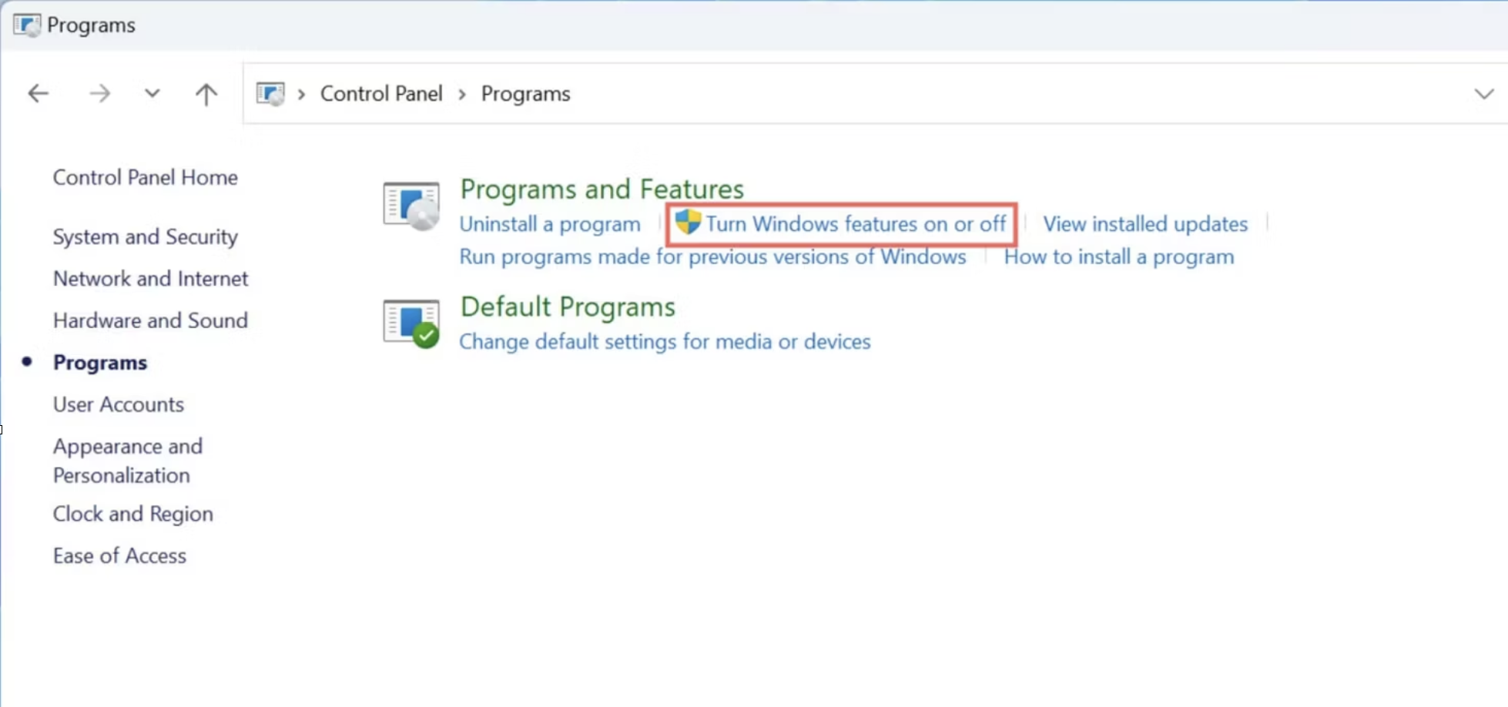
Select Turn Windows features on or off

Slide 6
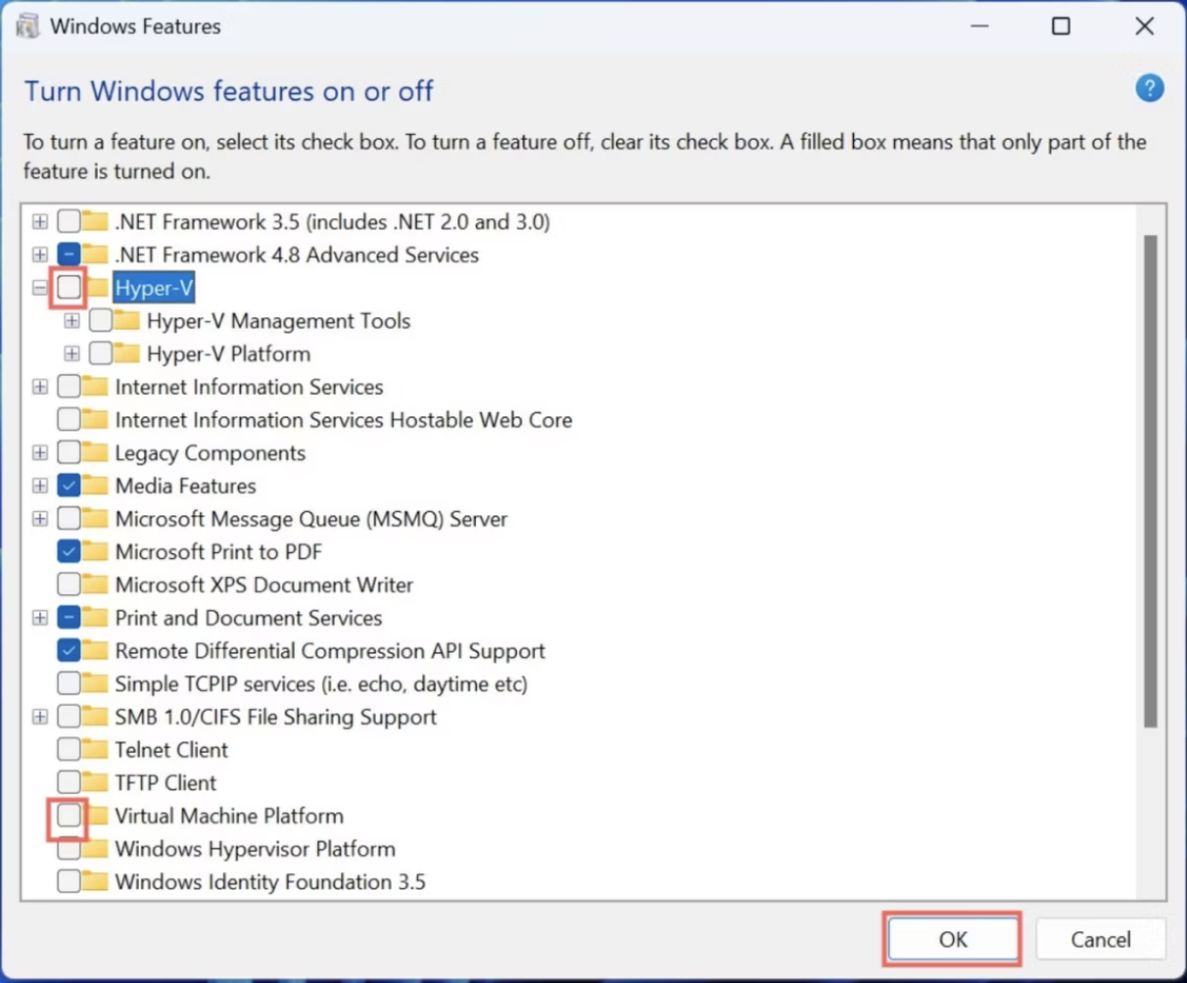
Scroll down until you spot Hyper-V in the Windows Features window and click on the checkmark next to it to disable Hyper-V.
INT-362
Adding hosts

Slide 7
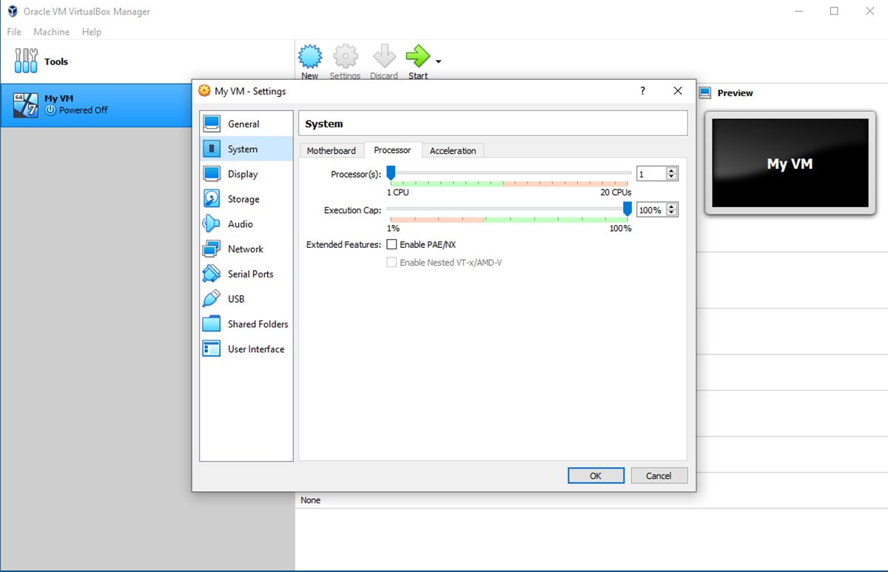
Set up VirtualBox nested virtualization
The system settings are divided into a series of tabs. Select the Processor tab, then the Enable Nested VT-x/AMD-V checkbox and click OK. Now the VM is ready for nested virtualization
open the settings of (powered off) virtual machine and go to System -> Processor, the option "Enable Nested VT-x/AMD-V" is greyed out and if it cannot be enabled.
open a new PowerShell in your VB installation folder and type:
./VBoxManage modifyvm "Virtual Machine Name" --nested-hw-virt on

Slide 8
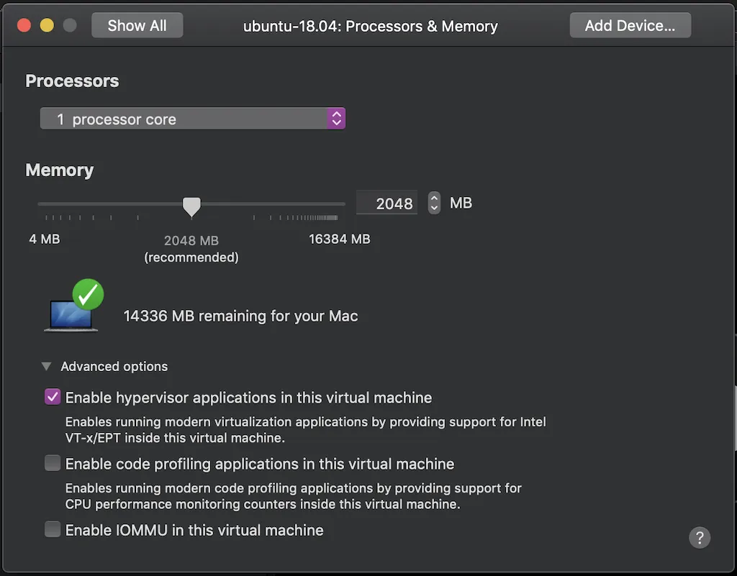
Set up nested virtualization in VMWare Fusion in MAC
It can be enabled by ticking the Enable hypervisor applications in this virtual machine option. This is found in the advanced options of the Processors & Memory screen for the virtual machine you want to run nested virtualization on.

Slide 9
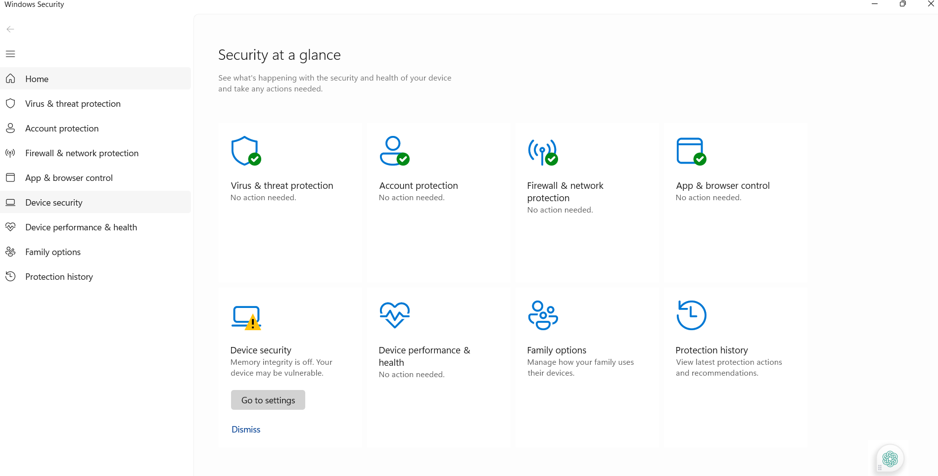
KVM install
Note:
Perform the following steps:
Go to: settings→ windows security→ Device Security→ core isolation→ memory integrity off
Step1: window security →device security →

Slide 10
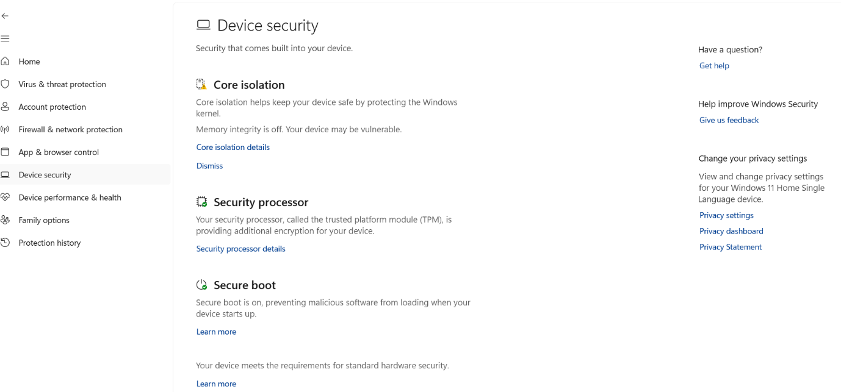
KVM install
Note:
Perform the following steps:
Go to: settings→ windows security→ Device Security→ core isolation→ memory integrity off

Slide 11
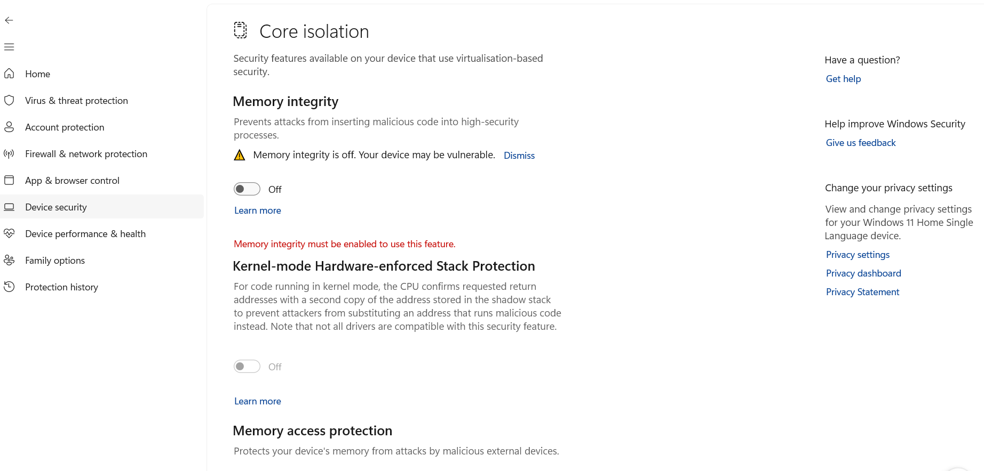
KVM install
Note:
Perform the following steps:
Go to: settings→ windows security→ Device Security→ core isolation→ memory integrity off
Step 3

Slide 12
Sudo su
Su root
Passwd root
Exit
apt install quota
apt install openssh-server
sudo sed -i "s/#PermitRootLogin.*/PermitRootLogin yes /" /etc/ssh/sshd_config
sed -i -e 's/^RPCMOUNTDOPTS="--manage-gids"$/RPCMOUNTDOPTS="-p 892 -- manage-gids"/g' /etc/default/nfs-kernel-server
sed -i -e 's/^STATDOPTS=$/STATDOPTS="--port 662 --outgoing-port 2020"/g' /etc/default/nfs-common
echo "NEED_STATD=yes" >> /etc/default/nfs-common
sed -i -e 's/^RPCRQUOTADOPTS=$/RPCRQUOTADOPTS="-p 875"/g' /etc/default/quota
apt install cloudstack-agent

Slide 13
sed -i -e 's/\#vnc_listen.*$/vnc_listen = "0.0.0.0"/g' /etc/libvirt/qemu.conf
sed -i -e 's/.*libvirtd_opts.*/libvirtd_opts="-l"/' /etc/default/libvirtd
echo LIBVIRTD_ARGS=\"--listen\" >> /etc/default/libvirtd
systemctl mask libvirtd.socket libvirtd-ro.socket libvirtd-admin.socket libvirtd-tls.socket libvirtd-tcp.socket
systemctl restart libvirtd
nano /etc/default/libvirtd
systemctl restart libvirtd
echo 'listen_tls=0' >> /etc/libvirt/libvirtd.conf
echo 'listen_tcp=1' >> /etc/libvirt/libvirtd.conf
echo 'tcp_port = "16509"' >> /etc/libvirt/libvirtd.conf
echo 'mdns_adv = 0' >> /etc/libvirt/libvirtd.conf

Slide 14
echo 'auth_tcp = "none"' >> /etc/libvirt/libvirtd.conf
systemctl restart libvirtd
apt-get install uuid
apt-get install uuid –y
UUID=$(uuid)
echo host_uuid = \"$UUID\" >> /etc/libvirt/libvirtd.conf
systemctl restart libvirtd
ln -s /etc/apparmor.d/usr.lib.libvirt.virt-aa-helper /etc/apparmor.d/disable/
apparmor_parser -R /etc/apparmor.d/usr.sbin.libvirtd
apparmor_parser -R /etc/apparmor.d/usr.lib.libvirt.virt-aa-helper
exit

